Slide 1
SOAP MESSAGE EXCHANGE MODEL

Slide 2
SOAP Message Exchange Model
Message path & Actors
Sender-Intermediary1-Intermediary2..-Receiver.
- . . message path …. -
- actor1 - actor 2 -
Construction of message path is not covered by SOAP specification , there are extensions to SOAP like Microsoft SOAP routing protocol to fill this gap
WS-Routing (But still there is no standard)
This mechanism only used in header block not in the body using actor attribute

Slide 3
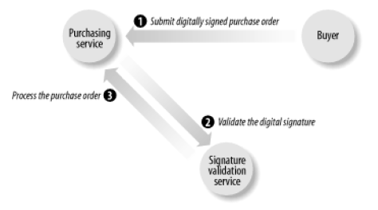
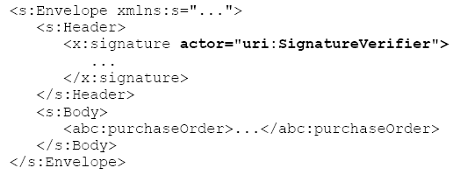
Example: actor

Slide 4
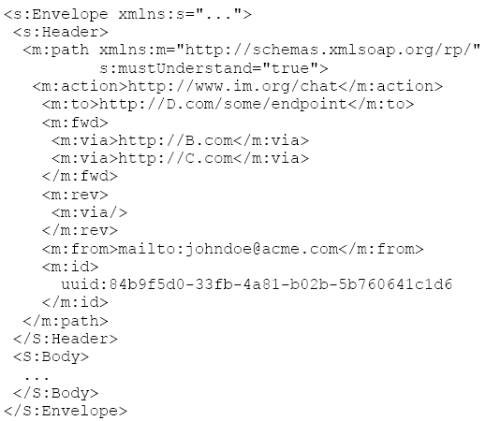
WS-Routing Message
V. Balasubramanian & K. Saravanan, VIT University

Slide 5
SOAP-Encoding
Envelope – packaging data
Message – Serialization of data
Encoding: ‘a simple type system that is the generalization of the common features found in programming languages, databases and semi-structured data’
Where encoding rules needed?
  To allow applications dynamically exchange information without a priori knowledge of the types of information to be exchanged.

Slide 6
Encoding…
Terminology : value & accessor
value : single / combination of data unit(s)
accessor:
element that contains / allows to access a value.
Accessor Types:
  Single referenced / multi referenced

Slide 7
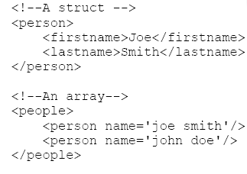
Structure & Arrays

Slide 8
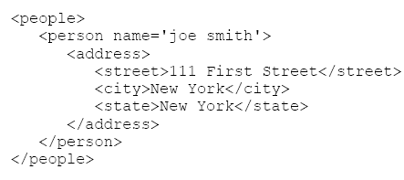
Single-referenced accessor
Does not have an identity except as a child of its parent element

Slide 9
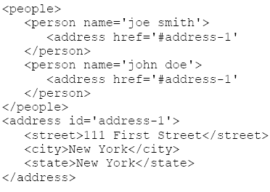
Multi-referenced accessor
Uses id to give identity to its value, other accessors can use the href attribute to refer to their values. ( the reference can also be an external XML document)

Slide 10
Data Types within SOAP envelope
SOAP uses 3 difference ways to express the data type of an accessor
  Use xsi:type on each accessor (data type according to XML schema specification)
    Ex: <person><name xsi:type=“xsd:string”>VIT</name></person>
  Reference an xsd that defines exact data type of a particular element
    <person xmlns=“VIT.xsd”> <name>VIT</name></person>
  Reference some other type of schema document
    <person xmlns=“urn:vit_namespace”><name>VIT</name></person>

Slide 11
SOAP Data Types
Anonymous accessor syntax
  <SOAP-ENC:int> 45 </SOAP-ENC:int>
Named accessor syntax
  <value xsi:type =“xsd:int”>45</value>
Multiple references in XML-encoded data
  <SOAP-ENC:int>31</SOAP-ENC:int>
  <SOAP-ENC:int>31</SOAP-ENC:int>
<value xsi:type="xsd:int" id="v1">31</value>
<value href="#v1" />

Slide 12
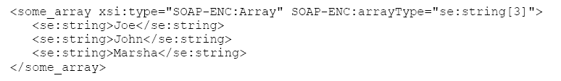
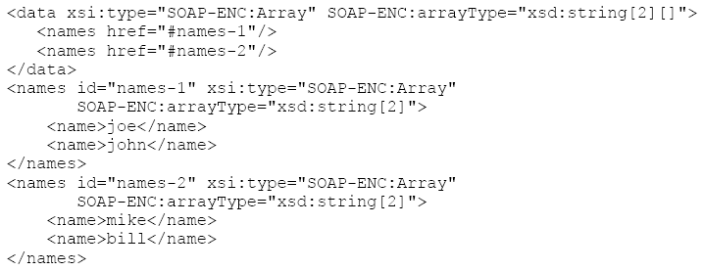
arrayType attribute
2-dimensional array

Slide 13
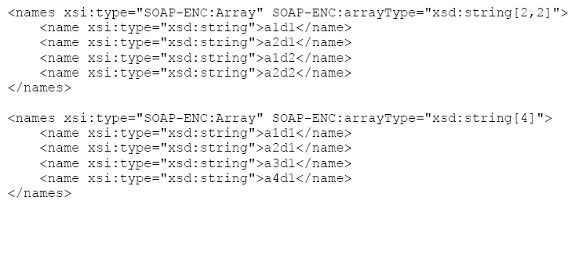
Comparison of 2-d and 1-d array

Slide 14
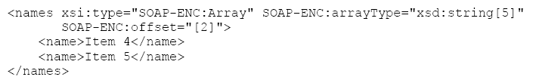
SOAP-ENC:offset for partially transmitted arrays

Slide 15

SOAP-Serialization of sparse arrays

Slide 16
Null accessors

Slide 17
SOAP Web Services (Refer Lecture Notes)
Creating web services in .NET
Deployment
Invoking the service using SOAP
System.Web.Services.WebServiceBindingAttribute
System.Web.Services.Protocols.SoapHttpClientProtocol
Interoperability issues
  SOAP faults,SOAP::LITE, Perl client to work with .NET.

